Slide 1
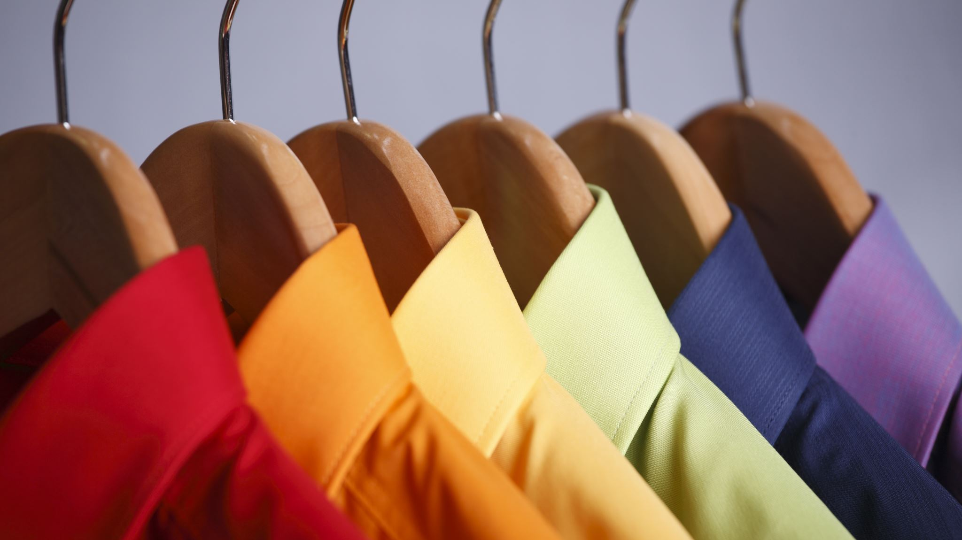
Dress to Impress
CCB Employment Conference 2021
Presenter - Jessica Marquez

Slide 2
Agenda
Appearance and Credibility
About Delivery
Appearance and Dress Tips
Makeup
Online Appearance - (Camera Usage and Lighting)
Posture

Slide 3
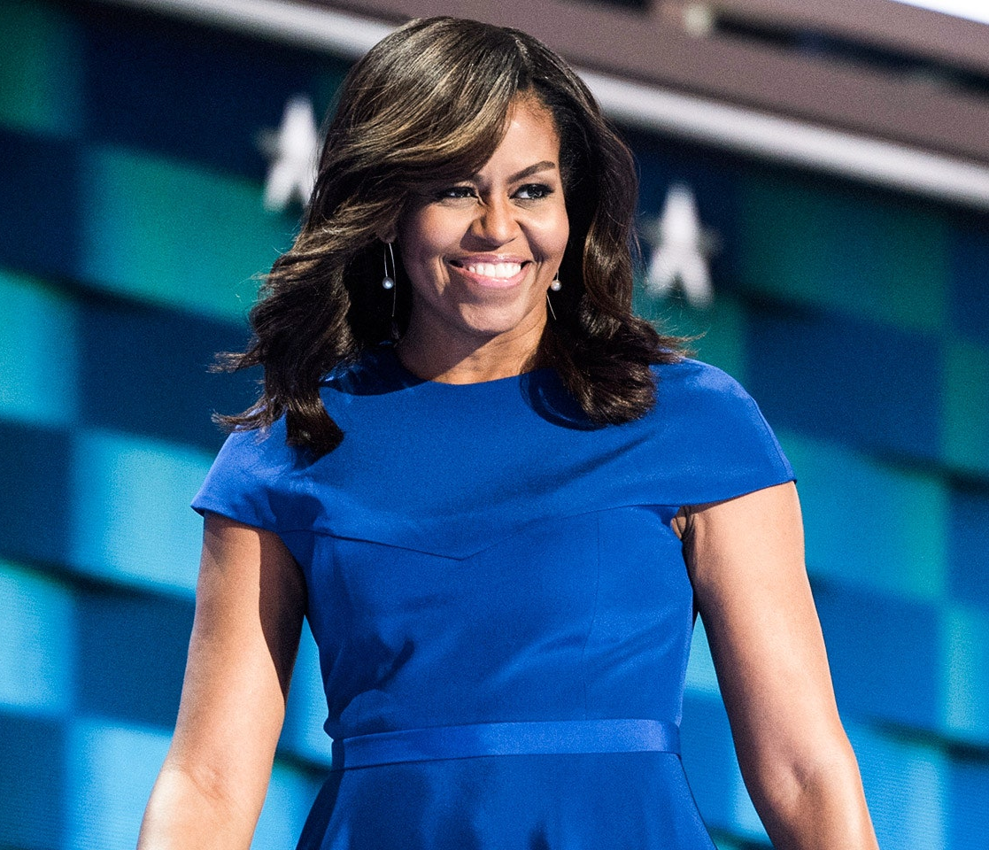
Why Appearance?
Appearance influence’s speakers' credibility.
Credibility - an audience’s perception that the speaker is well prepared and qualified to speak about a topic.
Michelle Obama at the Democratic National Convention

Slide 4
About Delivery
Delivery is the vocal and physical elements a speaker can use when presenting a speech (Capecce, 2012)
Verbal Delivery
Nonverbal Delivery

Slide 5
Appearance
Dress appropriately for the situation!
Need to be comfortable and confident in the way that you present yourself!
Pro Tip: Err on the side of formal
First impressions MATTER!
Be tidy and clean!

Slide 6
Dress
Watch out for keys in pockets!
Caution: long hair can be a distraction.
Personal appearance affects how audience will respond to the speaker.
Debating what to wear? Just go professional and conservative.

Slide 7
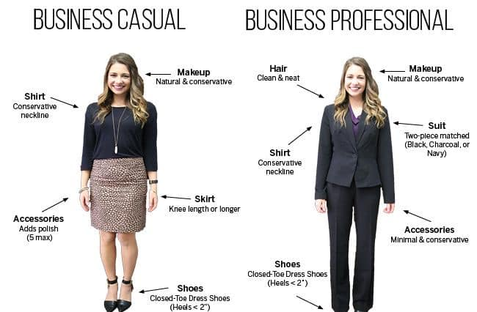
Attire for Women
Notes:
Diagram: Attire for Women
For Business Casual: Make sure makeup is natural and conservative, the blouse is conservative neckline, Shoes are closed toed and about a 2 inch heel or less, skirt is knee length or longer.
For Business Professional: A two piece suit in charcoal, navy or black colors is recommended. Accessories are minimal and conservative. Shoes are closed toed and 2 inch heel or shorter.

Slide 8
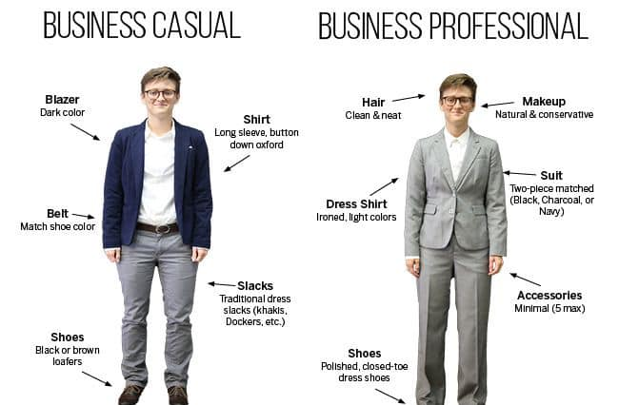
Attire for Men
And Gender Neutral
Notes:
Diagram: For Men and/or Gender Neutral Attire
For business causal, wear a blazer with a dark color, a shirt that is long sleeved and a button down oxford. Make sure to match belt and shoe color. For shoes, black or brown loafers. For pants, traditional slacks like khakis, Dockers, etc.
For business professional: Hair needs to be well kept and neat, makeup is natural and conservative, dress shirt is ironed and light colored, suit is two pieced and matching colors such as charcoal, navy or black. Keep accessories to a minimum of five.

Slide 9
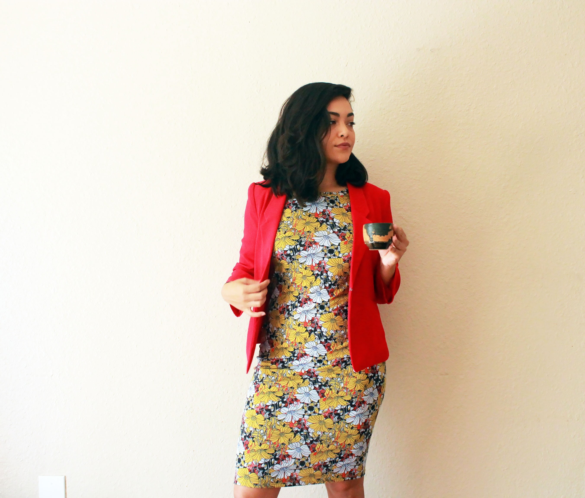
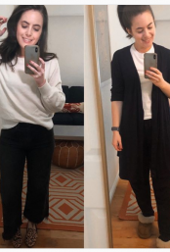
Examples

Slide 10
Makeup

Slide 11
Online Appearance

Slide 12
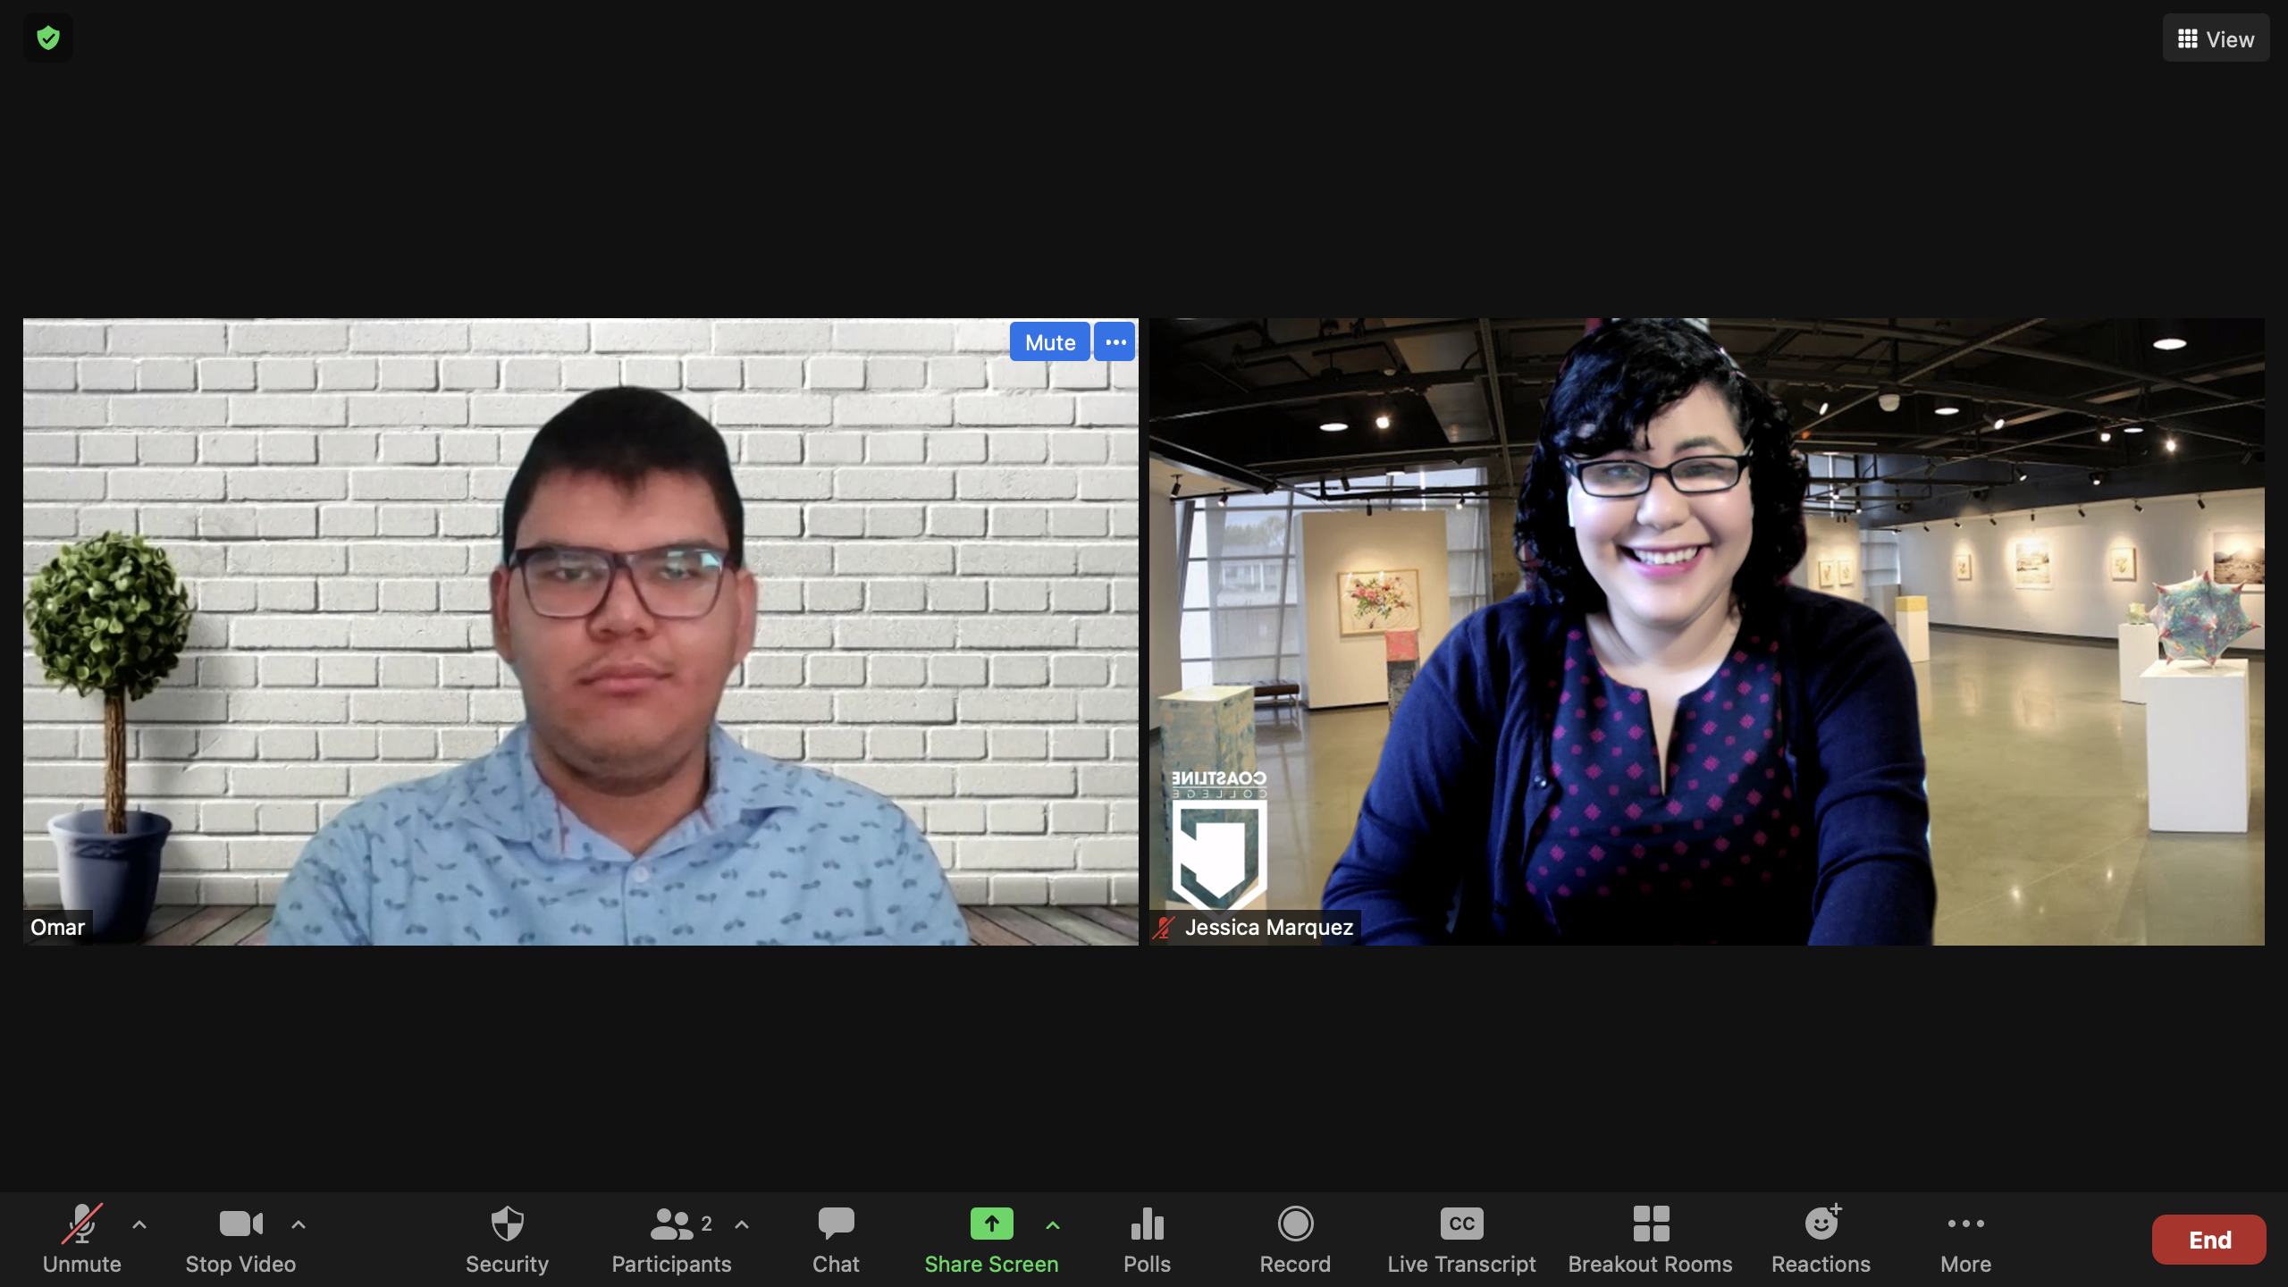
Camera Usage
Sit right in the center of the camera.
Prop the camera up with a box to be at forehead level.
Look straight at the center of the computer camera.

Slide 13
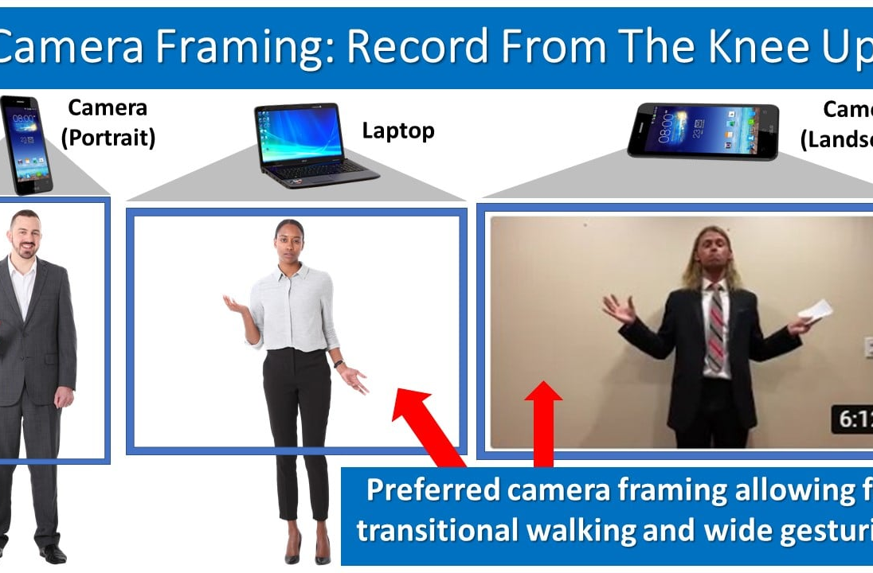
Recording on Zoom
Notes:
Picture showing how to place phone. Camera framing: record from the knee up. The preferred camera framing is when the phone is far away and can see from the waist up and in landscape mode.

Slide 14
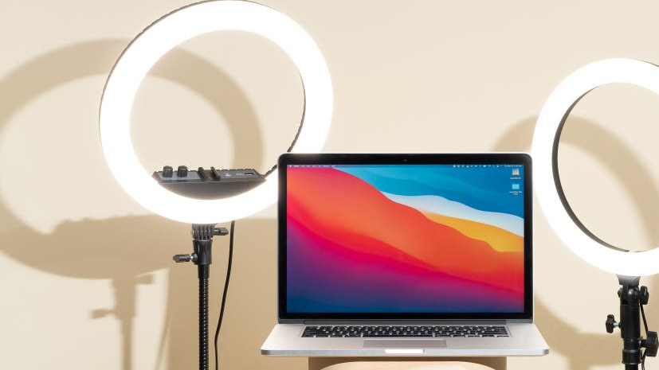
Lighting
Sit directly in front of a window for natural light.
For cloudy days, get a lamp to go on the other side of the computer to shine light.
Get a ring light if needed!

Slide 15
Posture
“Body stance, gestures, and facial expressions can be generally categorized as body language” (Capecce, 2012).
Watch out for slouching!
Avoid shifting from foot to foot.
Do not stalk people from behind.
Stand up straight with confidence!

Slide 16
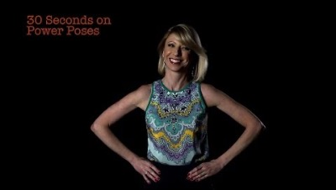
Power Pose
Amy Cuddy

Slide 17
Recap
Talked about how your appearance can enhance your credibility.
Talked about different methods to work on appearance
Talked about the 21st century for camera and lighting!
Talked about posture and power poses.

Slide 18

Q&A
Please feel free to ask any questions, comments, or concerns.

Slide 19
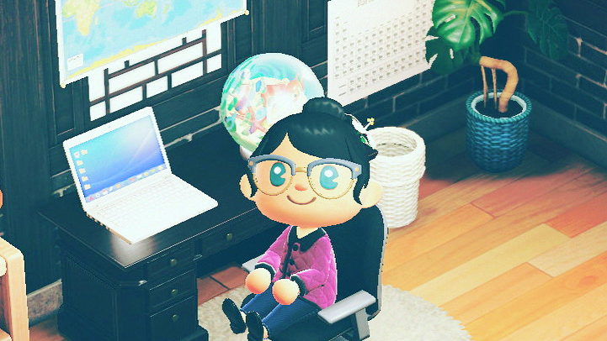
Have more questions?
Email: jmarquez@lbcc.edu
Instagram: @profjessmarq

